Slide 1

Twitter Airline Sentiment
Ben Fujii

Slide 2
Appendix
Dataset
“Twitter US Airline Sentiment” from Kaggle.com
Cleaned out irrelevant or unexplained columns
Dummy variables were used for predictive analysis/regression modeling
All work done within Microsoft Excel using pivot tables, data visualization, and regression analysis
Was unable to create bar graphs on Excel due to the negative coefficients blocking the labels

Slide 3
Dataset Breakdown
Originally 15 Columns and 14,640 Rows
Relevant Variable Breakdown:
airline_sentiment = attitude/perspective of the tweet, either positive, neutral, or negative
negativereason = reasoning for negative sentiment
airline = airline mentioned in the tweet
Six possible: American, Delta, Southwest, United, US Airway, Virgin America
text = the entire tweet itself
airline_sentiment_confidence = confidence score pertaining to the sentiment assigned to the tweet
Other variables such as negativereason_gold and airline_sentiment_gold were not described by the creator

Slide 4
Airline Summaries
Breakdowns of the number of tweets per airline and the sentiment of the tweets graphed below
United was the most tweeted about, while Virgin America was mentioned significantly less than every other airline
Every airline had more negatively focused tweets, which is understandable because it is more likely for an individual to tweet when they are frustrated than happy
United, US Airways, and American had a significantly high ratio of negative tweets to positive, indicating a weakness in customer satisfaction

Slide 5
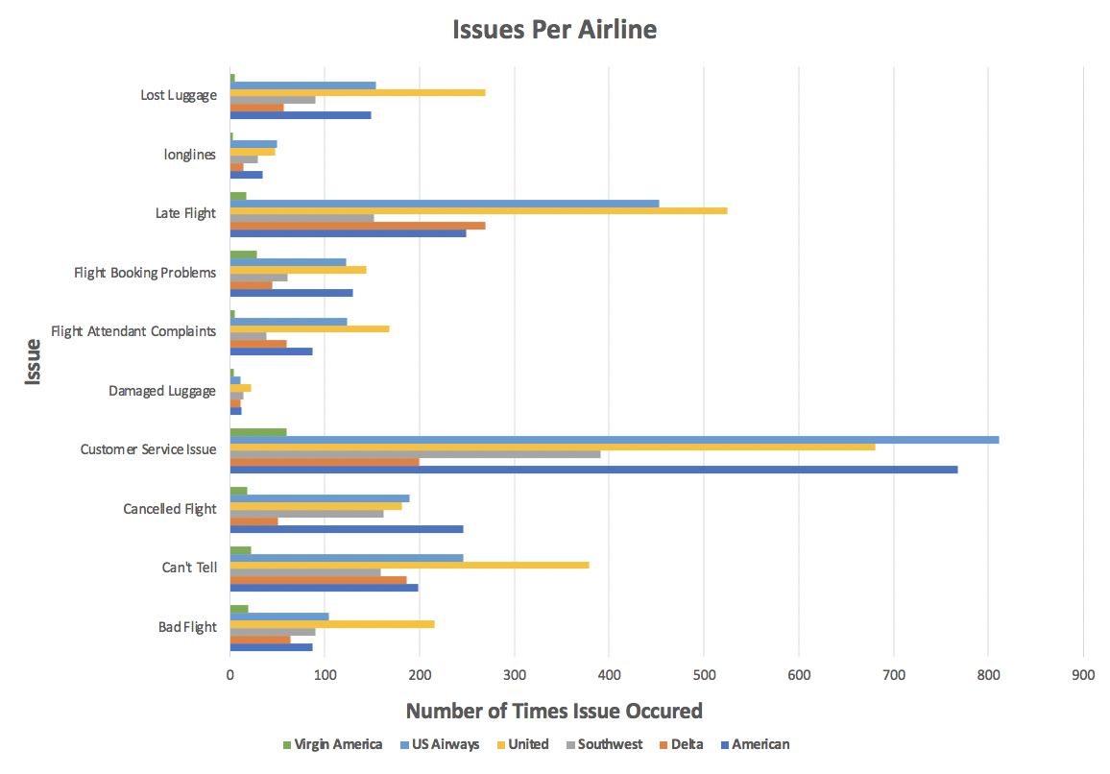
Causes of Negative Reviews
Common theme is poor customer service is the primary motivation behind customers writing negative tweets
Followed by delayed/late flights, indicating that these two aspects of the business need to be improved upon to maximize consumer satisfaction
Some airlines struggled more than others in specific areas
There are aspects the airlines are doing fairly well on, specifically damaged luggage and long lines
Miniscule numbers of consumers indicated these to be issues in their tweets
Customer service is a fixable issue that can be looked into based on the additional data in the dataset

Slide 6
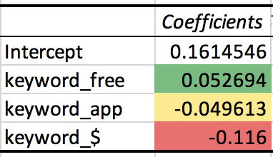
Key Words Relation to Positive Tweets
Found key words within the tweets that could play roles in the most commonly occurring issue that arose: customer service
The keyword free could give the airlines insight on whether offering more loyalty rewards or free benefits to customers would be beneficial
Each tweet that included the word ”free” was 5.3% more likely to be positive than the average tweet
This is a moderate increase and will ultimately be a decision of the company on whether offering free benefits will not be too costly
The keyword app will illustrate whether people are having positive experiences with the application or not
Every tweet that contained “app” were 5% less likely to be positive than the average
This indicates that the applications for the airlines need work in order to enhance the consumer experience, as it is currently hurting customer satisfaction
Looking for $ within each tweet will depict the consumers’ viewpoint on the pricing/value of the airlines
Every time a dollar sign is included in a tweet, it is 12% less likely to be positive, indicating the consumer base does not see reasonable value in the pricing of the airlines’ services.

Slide 7
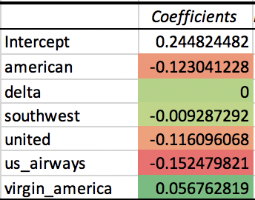
Airlines’ Overall Impact on Positive Reviews
Ran a regression model against each airline and a dummy on whether a tweet was positive or not (neutral/negative)
US Airways has the lowest coefficient of the bunch, indicating that a tweet that mentions them is 15% less likely to be positive than the average tweet
American Airlines, Southwest, and United all have negative coefficients, implying their higher likelihood of receiving a negative tweet
Virgin America has the highest coefficient of 5.7%, indicating a happier consumer base in comparison to the other airlines
The scale of each airline is important to consider
Smaller airlines have to receive much fewer positive tweets to have a positive coefficient
Overall, despite the size of many of the industry leaders, as they continue to grow, they increasingly struggle to satisfy their consumer base

Slide 8
Action Steps Taken
After cleaning the data, created dummy variables for:
Finding key words within the variable text
Each airline
airline_sentiment
Utilized pivot tables to depict the breakdown of tweets per airline and the positivity/negativity rates and graphed the results
Graphed the totals of each reason from all negative tweets about each airline to find the most common issues
Based on the most common issue, I found key words within each tweet to see its impact on consumer satisfaction
Ran a regression model that predicted for a positive tweet based off the keywords I chose about customer service, the most common issue
Ran another regression model that also predicted for a positive tweet based on the airline mentioned in the tweet
Showed an overall image of how each airline was doing in terms of customer satisfaction on Twitter

